Slide 1


13th Annual COVADIS Summit
（September 2, 2025, Madrid, Spain）
Session 1 National Network Updates
CMD registries in Japan (J-CMD)
and worldwide (Inter-CMD)
International University of Health and Welfare,
Tohoku University, Japan
Hiroaki Shimokawa, MD, PhD.

Slide 2
Japanese Association of CMD (J-CMD)
(Founded in 2022) （Supported by the Japan Heart Foundation）
北海道
Chairman： Hiroaki Shimokawa（IUHW）
N=32
・ Tohoku Univ
・ Gifu Heart Center
・ Gifu Pref General Med C
青森
秋田
・ IUHW Hosp
・ Teikyo Univ
・ Kawasaki Med Univ
岩手
・ Ohmi Med Ctr
・ Tsuchiura Kyodo General Hosp.
・ Kurume Univ.
・ Fukuoka Sanno Hosp.
・ NCVC
・ Osaka Univ.
山形
宮城
沖縄
・ Showa Univ.
・ Tokyo Med Univ., Hachioji Med C.
・ National Defense Medical Coll.
・ Ikegami General Hosp.
・ Tokyo Med Dental Univ.
富山
新潟
福島
石川
島根
鳥取
京都
福井
長野
群馬
栃木
山口
広島
岡山
兵庫
岐阜
埼玉
茨城
・ Kumamoto Univ.
福岡
滋賀
山梨
東京
佐賀
香川
大阪
愛知
神奈川
千葉
長崎
愛媛
奈良
三重
静岡
大分
高知
徳島
・ Chiba Univ.
・ IUHW Hosp. (Narita)
・ Miyazaki Univ.
熊本
和歌山
・ Mie Univ.
宮崎
・ Ehime Univ.
鹿児島
・ Wakayama Med Univ.
・ Fujita Med Univ.
・ Aichi Med Univ.
・ Showa Univ. Fujigaoka Hosp.
・ Kawaski Saiwai Hosp.

Slide 3
CMD registry by J-CMD（as of August 25, 2025）
1233

Slide 4
Ongoing clinical studies by J-CMD
１．CMD and air pollution/oxidative stress（Kumamoto Univ.）（Prof. Tsujita）
２．Different involvement of CMD/VSA in angina（Gifu Heart Center）（Dr. Matsuo）
３．Prognostic impacts of CFR and IMR in CMD（Chiba Univ.）（Prof. Kobayashi）
４．CMD after PCI （Wakayama Medical Univ.）（Prof. Tanaka）
５．Phenotyping and prevalence/overlap of CMD in patients with ANOCA
（Tsuchiura Kyodo Hosp.） （Dr. Kakuta）
６．Significance of mental stress/depression in patients with INOCA（Kumamoto Univ.）
（Prof. Tsujita）
７．Involvement of MINOCA and its prognostic impact in asymptomatic OMI
(Kumamoto Univ.）（Prof. Tsujita）

Slide 5
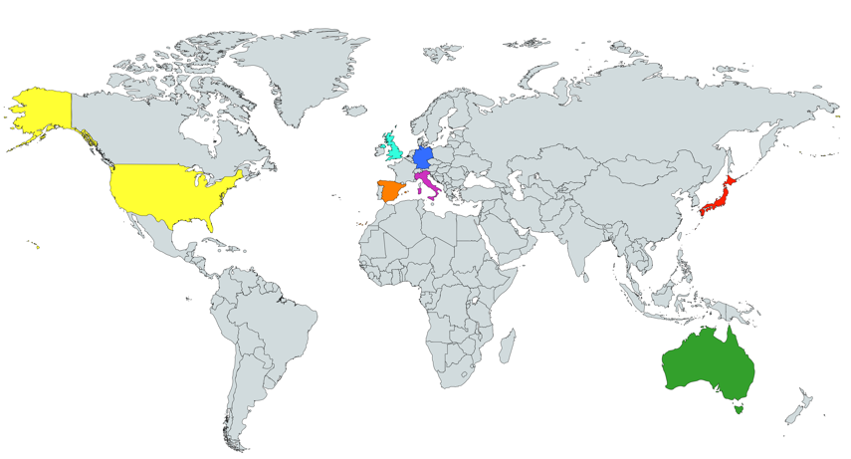
International, Prospective Cohort Study on MVA
by COVADIS
Multi-center study (14 institutes in 7 countries)（July 2015～December 2019）
UK
Prof. Juan Carlos Kaski
(St .George’s University)
Prof. Colin Berry
(University of Glasgow)
Germany
Dr. Peter Ong
Prof. Udo Sechtem
(Robert-Bosch-Krankenhaus)
Spain
Prof. Javier Escaned
(Hospital Clinico San Carlos)
Japan
Prof. Hiroaki Shimokawa
(Tohoku University)
Australia
Prof. John Beltrame
(University of Adelaide)
USA
Prof. C. Noel Bairey Merz
(Cedars-Sinai Medical Center)
Dr. Basmah Safdar
(Yale University)
Italy
Prof. Paolo G. Camici
(Vita-Salute San Raffaele University)
Prof. Filippo Crea
(Catholic University of the Sacred Heart)
(Shimokawa H, et al. Eur Heart J. 2021;42:4592-4600.)

Slide 6
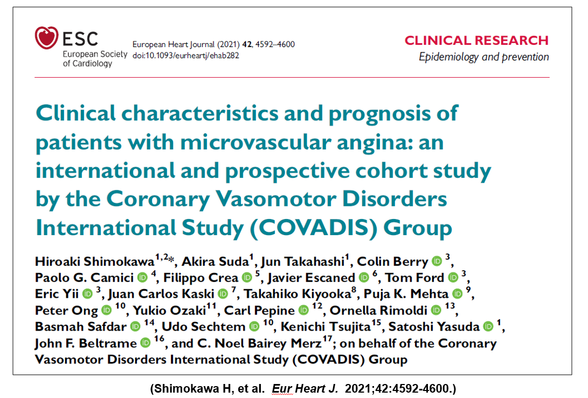
International, Prospective Cohort Study on MVA
by COVADIS
Multi-center study (14 institutes in 7 countries)（July 2015～December 2019）
UK
Prof. Juan Carlos Kaski
(St .George’s University)
Prof. Colin Berry
(University of Glasgow)
Germany
Dr. Peter Ong
Prof. Udo Sechtem
(Robert-Bosch-Krankenhaus)
Spain
Prof. Javier Escaned
(Hospital Clinico San Carlos)
Japan
Prof. Hiroaki Shimokawa
(Tohoku University)
Australia
Prof. John Beltrame
(University of Adelaide)
USA
Prof. C. Noel Bairey Merz
(Cedars-Sinai Medical Center)
Dr. Basmah Safdar
(Yale University)
Italy
Prof. Paolo G. Camici
(Vita-Salute San Raffaele University)
Prof. Filippo Crea
(Catholic University of the Sacred Heart)
(Shimokawa H, et al. Eur Heart J. 2021;42:4592-4600.)

Slide 7
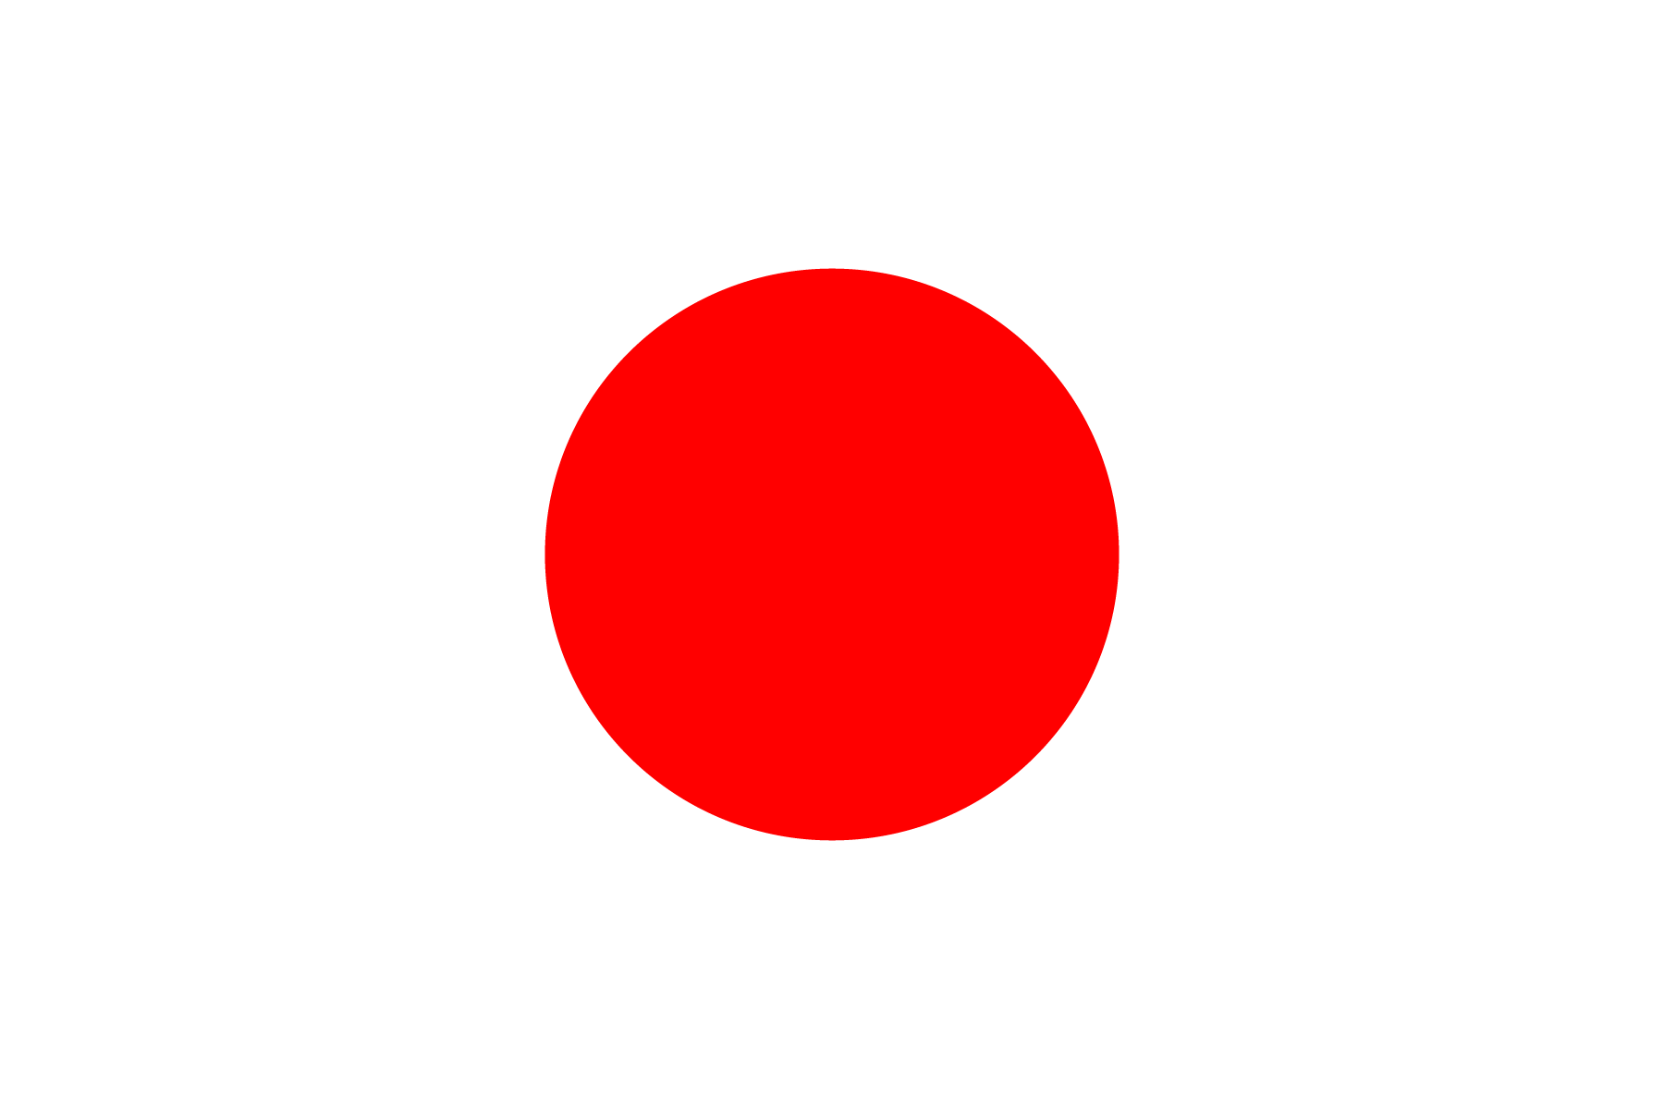




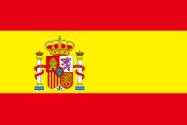

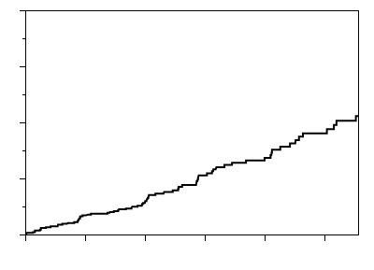
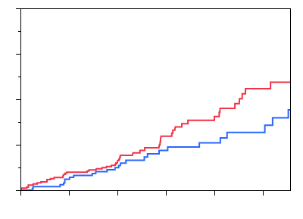
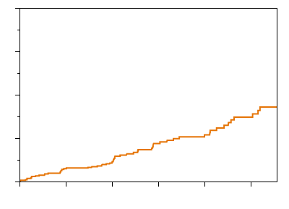
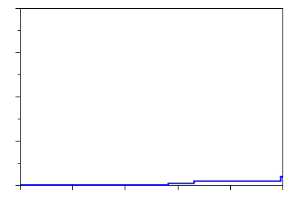
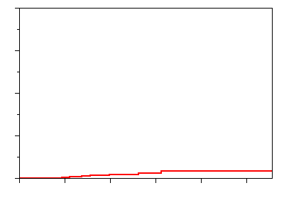
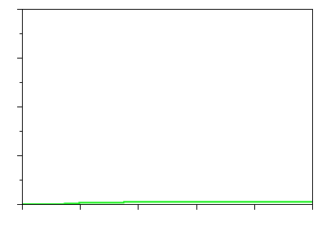
The international cohort study on MVA by COVADIS (N=686)
(N=191)
(N=171)
(N=109)
(N=88)
(N=59)
(N=51)
(N=17)
A
Ethnicity
Sex
Age
Risk factors
Others
<50
(15%)
<80
Dyslipidemia
52%
Hispanic
Male
(36%)
60s
(31%)
Hypertension
52%
Asian
(29%)
Female
(64%)
70s
(23%)
Caucasian
(61%)
Diabetes mellitus
17%
50s
(29%)
Current smoking
16%
D
0
20
40
60
(%)
B
Sex differences in SAQ
C
40
40
Incidence of MACE in the overall cohort
Sex difference in the incidence of MACE
Physical
limitation
Total MACE (N=78)
P<0.0001
30
30
Male (N=248)
Angina
stability
Unstable angina (N=63)
Female (N=438)
P<0.0001
Cardiovascular death (N=9)
Angina
frequency
20
Myocardial infarction (N=5)
20
Cumulative incidence of MACE (%)
Log rank P=0.19
P<0.0001
Acute heart failure (N=1)
Treatment
satisfaction
10
10
P=0.03
Disease
perception
P=0.004
0
0
24
0
20
40
60
80
100
0
6
12
18
24
30
0
6
12
18
30
Follow-up (months)
No. at risk
Follow-up (months)
Male (N=248)
SAQ score
No. at risk
Male
248
238
216
120
90
59
Female (N=438)
678
637
336
227
144
95
Female
430
405
351
133
103
59
(Shimokawa H, et al. Eur Heart J. 2021;42:4592-4600.)

Slide 8
The international cohort study on MVA by COVADIS (N=686)
Remaining Questions
Ethnic and sex differences in
1. Clinical characteristics
2. Treatments
3. Long-term prognosis
4. Biomarkers
(N=191)
(N=171)
(N=109)
(N=88)
(N=59)
(N=51)
(N=17)
A
Ethnicity
Sex
Age
Risk factors
Others
<50
(15%)
<80
Dyslipidemia
52%
Hispanic
Male
(36%)
60s
(31%)
Hypertension
52%
Asian
(29%)
Female
(64%)
70s
(23%)
Caucasian
(61%)
Diabetes mellitus
17%
50s
(29%)
Current smoking
16%
D
0
20
40
60
(%)
B
Sex differences in SAQ
C
40
40
Incidence of MACE in the overall cohort
Sex difference in the incidence of MACE
Physical
limitation
Total MACE (N=78)
P<0.0001
30
30
Male (N=248)
Angina
stability
Unstable angina (N=63)
Female (N=438)
P<0.0001
Cardiovascular death (N=9)
Angina
frequency
20
Myocardial infarction (N=5)
20
Cumulative incidence of MACE (%)
Log rank P=0.19
P<0.0001
Acute heart failure (N=1)
Treatment
satisfaction
10
10
P=0.03
Disease
perception
P=0.004
0
0
24
0
20
40
60
80
100
0
6
12
18
24
30
0
6
12
18
30
Follow-up (months)
No. at risk
Follow-up (months)
Male (N=248)
SAQ score
No. at risk
Male
248
238
216
120
90
59
Female (N=438)
678
637
336
227
144
95
Female
430
405
351
133
103
59
(Shimokawa H, et al. Eur Heart J. 2021;42:4592-4600.)

Slide 9
International CMD study by COVADIS and J-CMD
(Inter-CMD Study)
Running cost
(Sponsor: Japan Heart Foundation, Abbott)
2. IRB approval
3. Online registration system (available from Oct 1)
4. Data management (J-CMD)
5. Data analysis (J-CMD)

Slide 10
Inter-CMD study by J-CMD and COVADIS
1．J-CMD (N=12)
＊Rep Hiroaki Shimokawa（IUHW / Tohoku Univ）
① Tsuchiura Kyodo Hosp（Tsunekazu Kakuta）
② Intern’l Univ of Health Welfare（Morihiko Takeda）
③ Kawaski Med Univ（Shiro Uemura）
④ Wakayama Med Univ（Atsushi Tanaka）
⑤ IUHW Atami / Ikgami Gen Hosp（Takahiko Kiyooka）
⑥ Gifu Heart Center（Hitoshi Matsuo）
⑦ Chiba Univ（Yoshio Kobayashi）
⑧ Kumamoto Univ（Kenichi Tsujita）
⑨ Mie Univ（Kaoru Dohi）
⑩ Kurume Univ（Yoshihiro Fukumoto）
⑪ Miyazaki Univ（Koichi Kaikita）
⑫ Tohoku Univ（Satoshi Yasuda）
2．COVADIS (N=9)
① Co-Rep. Noel Bairey Merz, Cedars-Sinai Med Ctr (USA)
② Co-Rep. John Beltrame, Univ of Adelaide (Australia)
③ Colin Berry, Glasgow University (UK)
④ Paolo Camici/Alaide Chieffo, San Raffaele Hosp (Italy)
⑤ Javier Escaned, Hospital Clinico San Carlos (Spain)
⑥ Filippo Crea, Catholic University in Rome (Italy)
⑦ Juan Carlos Kaski/Ranil Silva, Imperial College (UK)
⑧ Peter Ong, Robert Bosch Hospital (Germany)
⑨ Carl Pepine, University of Florida (USA)
⑩ Hiroaki Shimokawa (Japan)

Slide 11
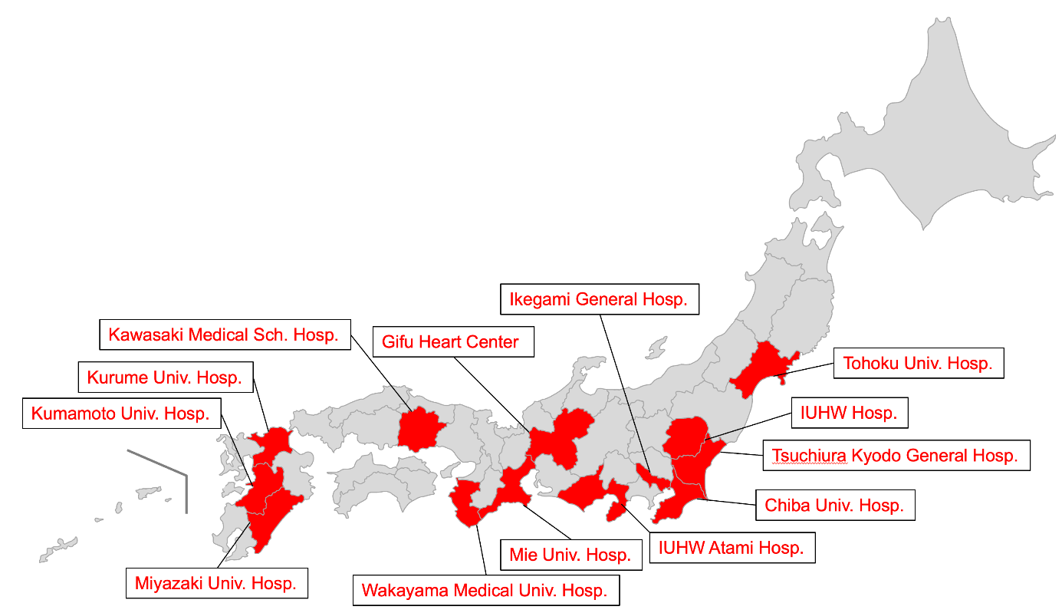
Inter-CMD participating institutes
Chairman： Hiroaki Shimokawa （Int’l Univ. of Health and Welfare, Narita, Japan）
Germany
(22 current participating centers)
UK
Robert Bosch Hospital
Glasgow University
Imperial College
Italy
USA
San Raffaele Hospital
Catholic University in Rome
Cedars-Sinai Medical Center
University of Florida
Spain
Japan
Hospital Clinico San Carlos
Japan
Singapore
National Univ of Singapore
Australia
University of Adelaide

Slide 12
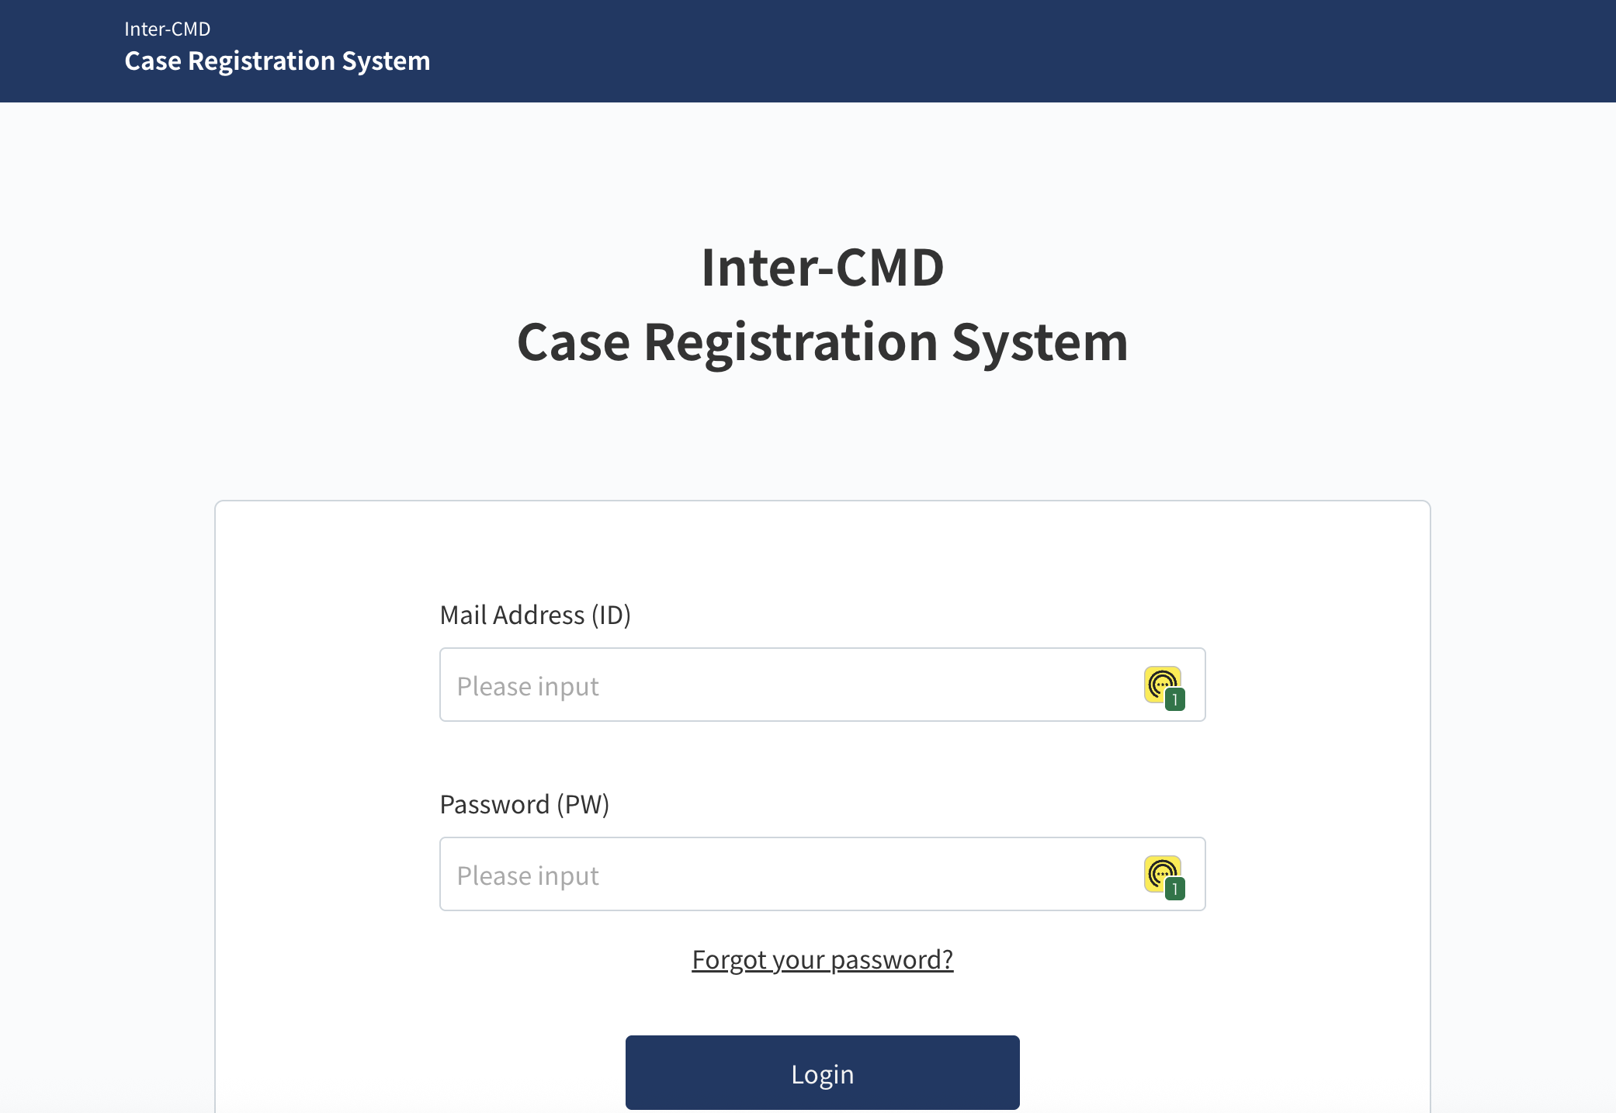
https://inter-cmd.net/
March 2023 ～ September 2025 (Retrospective), October 2025 ～ (Prospective)

